Slide 1
乐观估计 （Optimistic Estimate）
Cat book
2024年5月

Slide 2
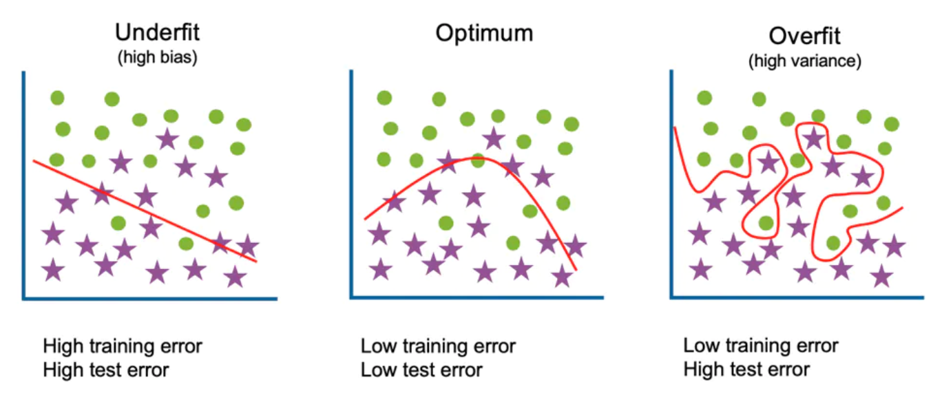
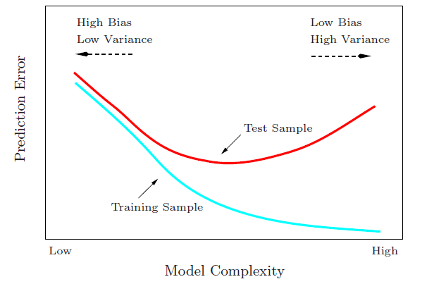
传统的泛化观点
Generalization Gap
思考：假设空间的复杂度高必然导致泛化误差大吗？

Slide 3
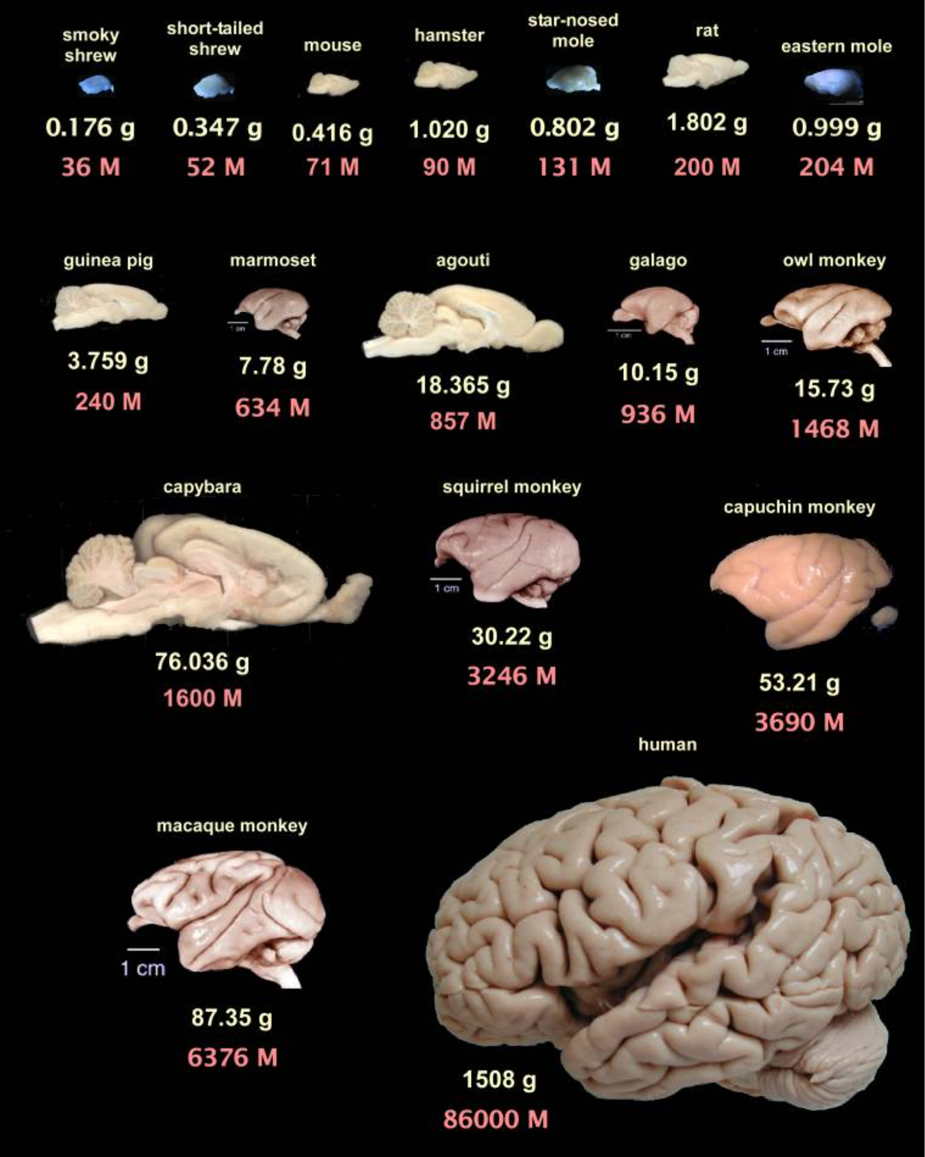
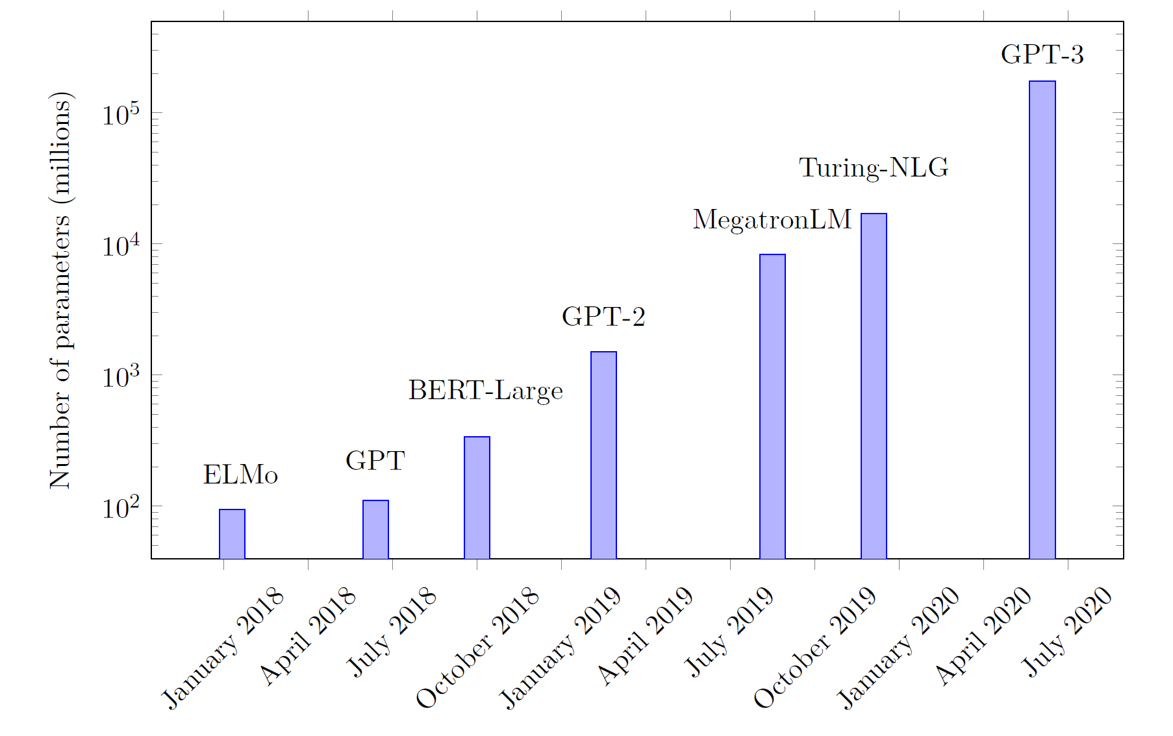
神经网络越来越大
Guillaume Hocquet. Class Incremental Continual Learning in Deep Neural Networks. Université Paris-Saclay, 2021
Suzana Herculano-Houzel, 2009

Slide 4
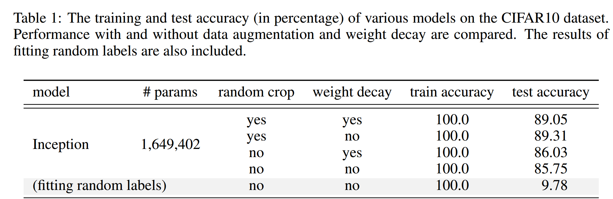
深度学习中的泛化谜团
Puzzle: generalize well even # of para >> # of training data
60000 32x32 colour images in 10 classes
L. Breiman 1995, Zhang et al., 2016

Slide 5

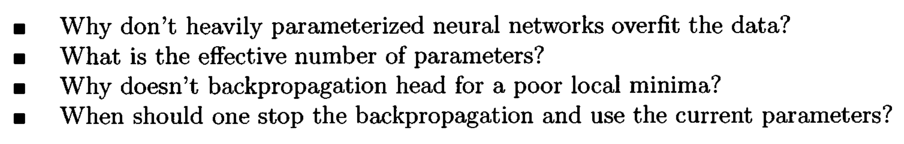
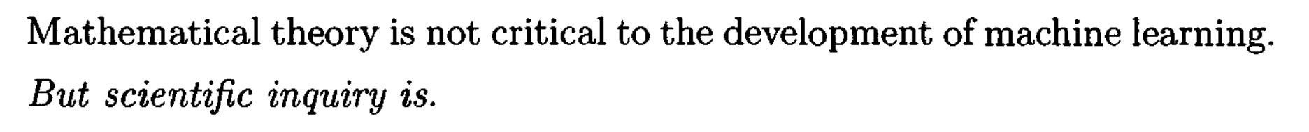
泛化谜团是长期以来的问题
1995

Slide 6
传统的最差估计

Slide 7
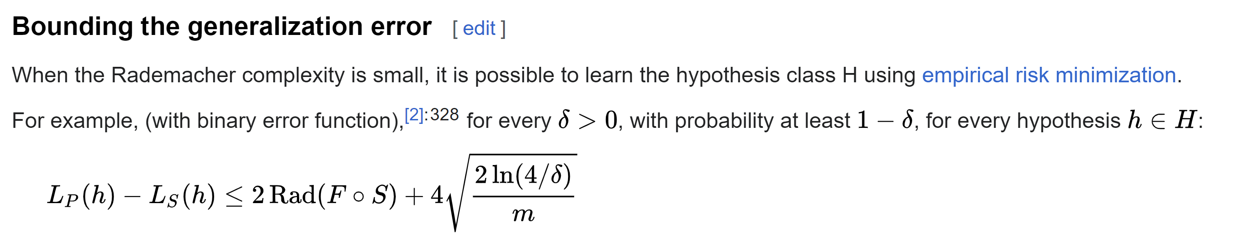
Rademacher complexity
Worst case estimation

Slide 8
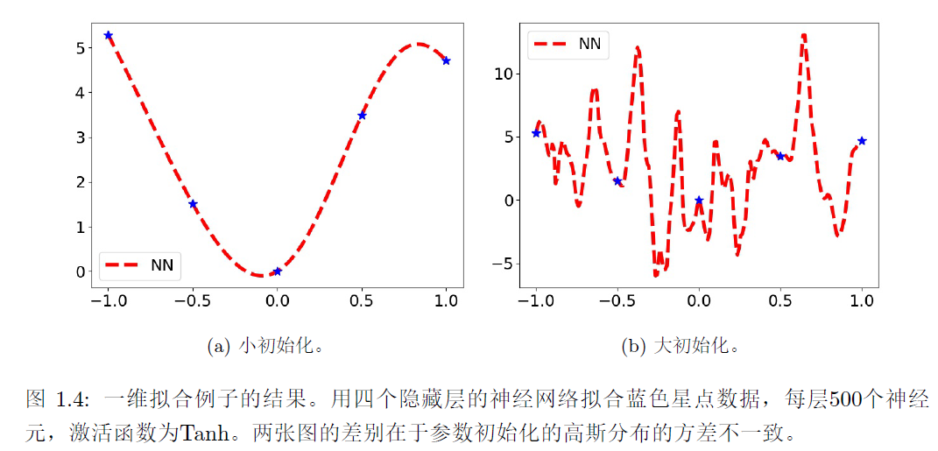
A same model can be good or be bad
Bad case

Slide 9
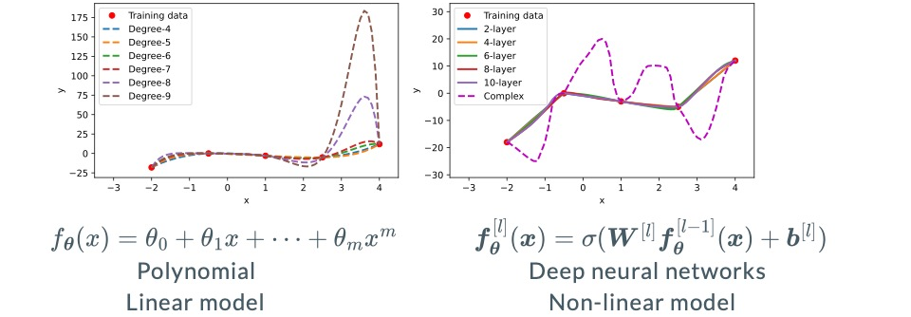
Worst case is not useful

Slide 10
It is right! But not useful in practical neural networks!

Slide 11
实验启发的乐观估计

Slide 12
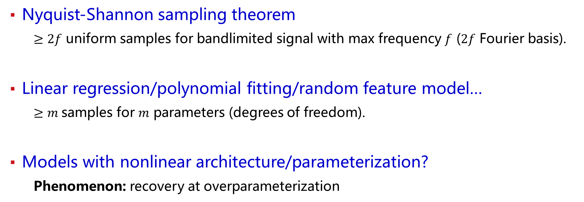
Old problem: sample size for exact recovery
For a model with M parameters, how many samples is needed?
Traditionally, Worst case estimation: M
Nyquist-Shannon sampling theorem
$≥2f$ uniform samples for bandlimited signal with max frequency $f$ ($2f$ Fourier basis).
Linear regression/polynomial fitting/random feature model…
$≥m$samples for $m$ parameters (degrees of freedom).
Models with nonlinear architecture/parameterization?
Phenomenon: recovery at overparameterization

Slide 13
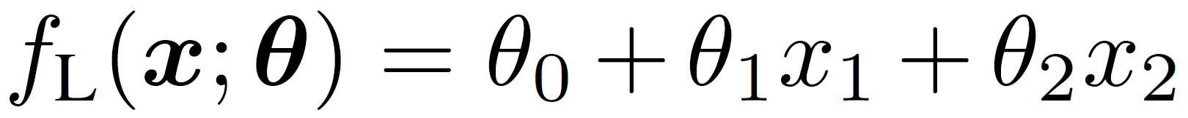
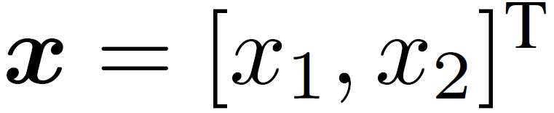
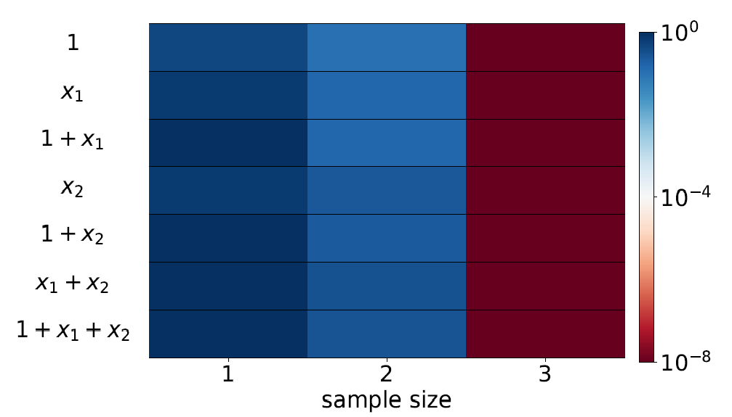
Linear regression
Model
Test error
Target function
Yaoyu Zhang*, Zhongwang Zhang, Leyang Zhang, Zhiwei Bai, Tao Luo, Zhi-Qin John Xu*, Optimistic Estimate Uncovers the Potential of Nonlinear Models, arxiv 2307.08921

Slide 14
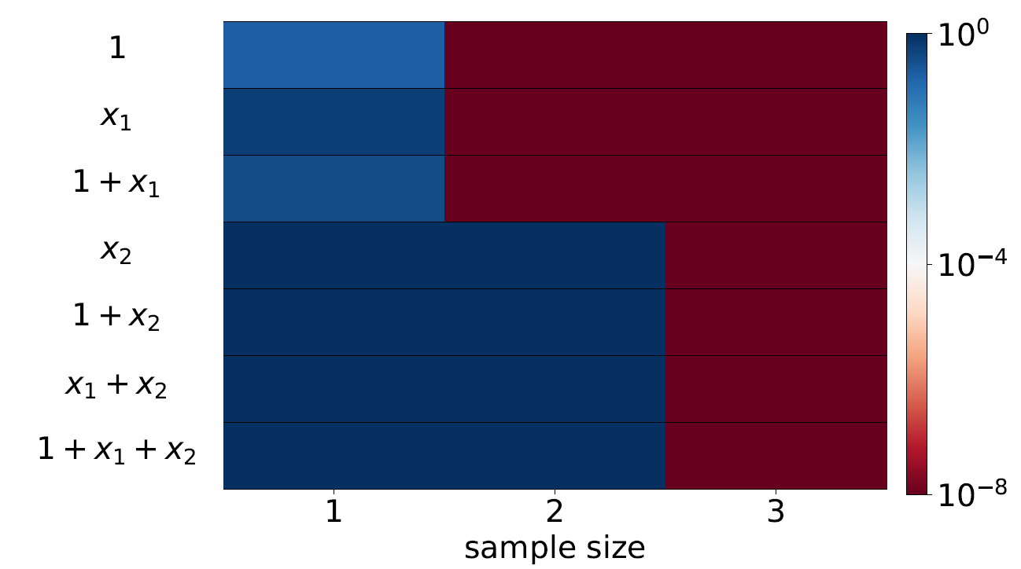
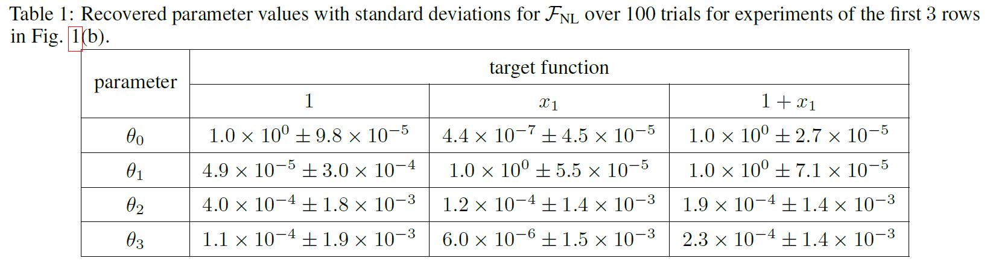
Non-Linear regression
思考：用这个模型恢复目标函数需要采样几个数据点？
Start with small initialization
Yaoyu Zhang*, Zhongwang Zhang, Leyang Zhang, Zhiwei Bai, Tao Luo, Zhi-Qin John Xu*, Optimistic Estimate Uncovers the Potential of Nonlinear Models, arxiv 2307.08921

Slide 15
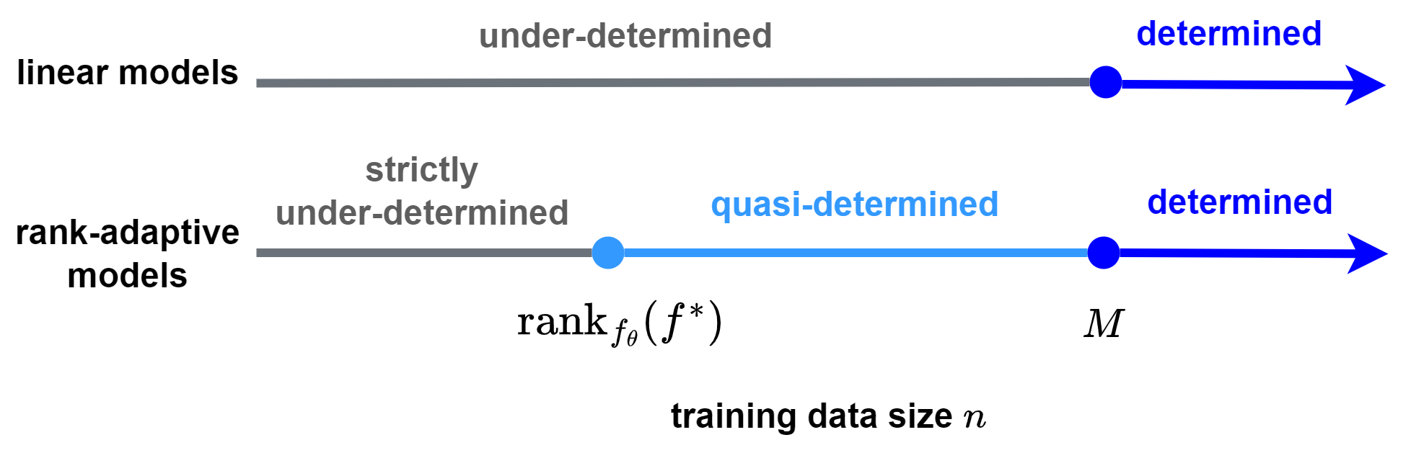
Rethinking: Generalization, sample, parameter
For a model with M parameters, how many samples is needed?
Traditionally, Worst case estimation: M
0
?
M
Optimistic estimation
Example: Teacher-Student setup
Target: a net of two neurons, 6 parameters
Model: a net of 1000 neurons, 3000 parameters
……
Model
Target

Slide 16
全局最小点局部的乐观估计

Slide 17
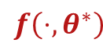
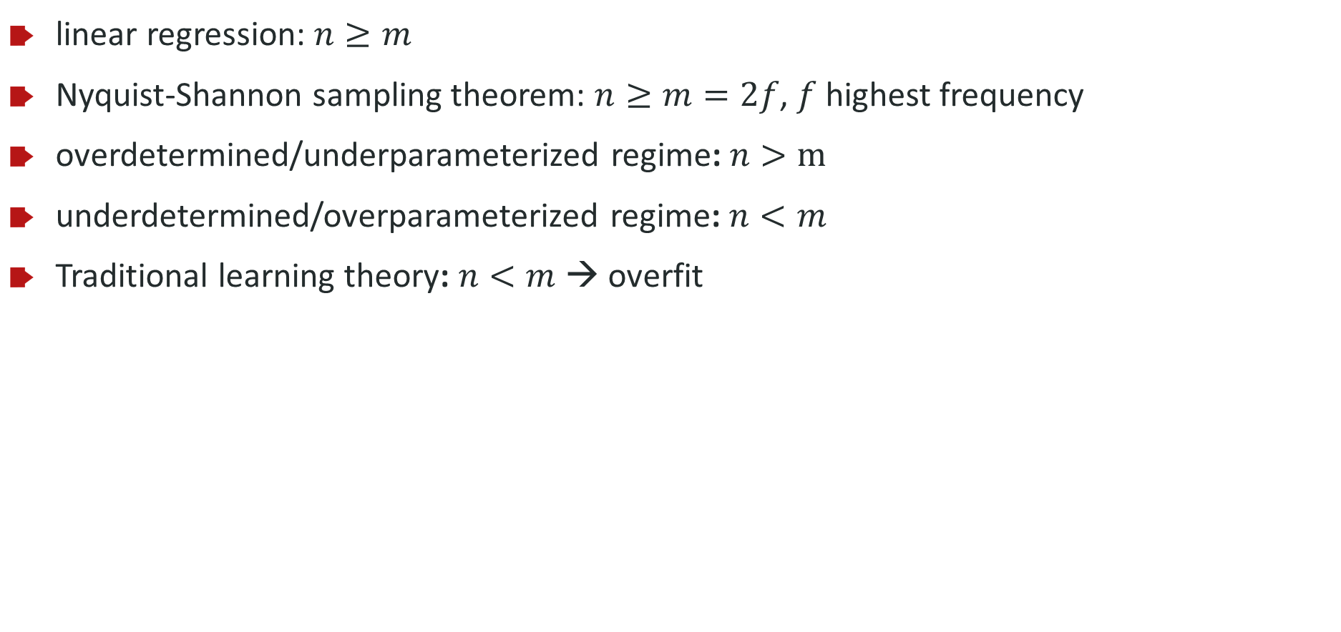
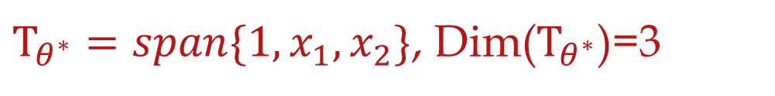
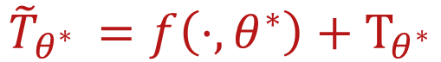
Linear model for recovery
linear regression: $n≥m$
Nyquist-Shannon sampling theorem: $n≥m=2f$, $f$ highest frequency
overdetermined/underparameterized regime: $n>m$
underdetermined/overparameterized regime: $n<m$
Traditional learning theory: $n<m$ → overfit
$${\tilde{T}}_{θ^{∗} }=f\left(⋅,θ^{∗}\right)+Τ_{θ^{∗}}$$
$$f\left(⋅,θ^{∗}\right)$$
$Τ_{θ^{∗}}=span\{1,x_{1},x_{2}\}$, Dim($Τ_{θ^{∗}}$)=3
Yaoyu Zhang*, Zhongwang Zhang, Leyang Zhang, Zhiwei Bai, Tao Luo, Zhi-Qin John Xu*, Optimistic Estimate Uncovers the Potential of Nonlinear Models, arxiv 2307.08921

Slide 18
For a LINEAR model
Data number=parameter number
Yaoyu Zhang*, Zhongwang Zhang, Leyang Zhang, Zhiwei Bai, Tao Luo, Zhi-Qin John Xu*, Optimistic Estimate Uncovers the Potential of Nonlinear Models, arxiv 2307.08921

Slide 19

For a NON-LINEAR model
Data number$≤$parameter number
Yaoyu Zhang*, Zhongwang Zhang, Leyang Zhang, Zhiwei Bai, Tao Luo, Zhi-Qin John Xu*, Optimistic Estimate Uncovers the Potential of Nonlinear Models, arxiv 2307.08921

Slide 20
For a NON-LINEAR model
What is the most optimistic case?
Yaoyu Zhang*, Zhongwang Zhang, Leyang Zhang, Zhiwei Bai, Tao Luo, Zhi-Qin John Xu*, Optimistic Estimate Uncovers the Potential of Nonlinear Models, arxiv 2307.08921

Slide 21
For a NON-LINEAR model
What is the most optimistic case?
Initialize very close to global minina!
$$f\left(⋅;θ \right)≈f^{lin}\left(⋅;θ \right)=f^{∗}\left(⋅\right)+∇_{θ}f\left(⋅;θ^{′}\right)(θ−θ′)$$
Yaoyu Zhang*, Zhongwang Zhang, Leyang Zhang, Zhiwei Bai, Tao Luo, Zhi-Qin John Xu*, Optimistic Estimate Uncovers the Potential of Nonlinear Models, arxiv 2307.08921

Slide 22
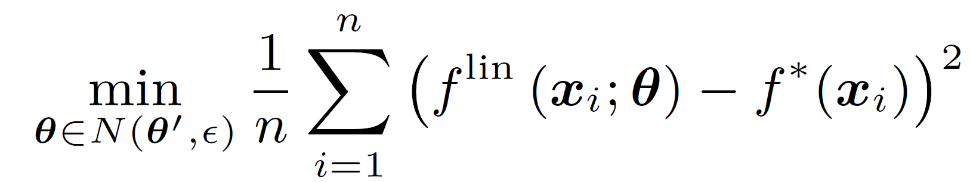
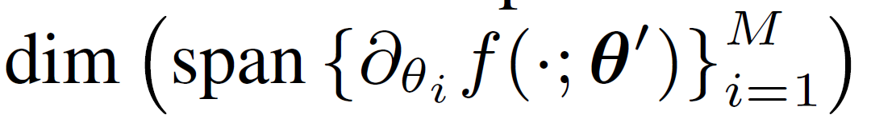
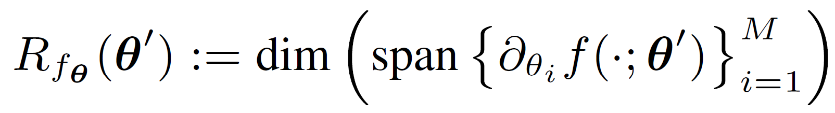
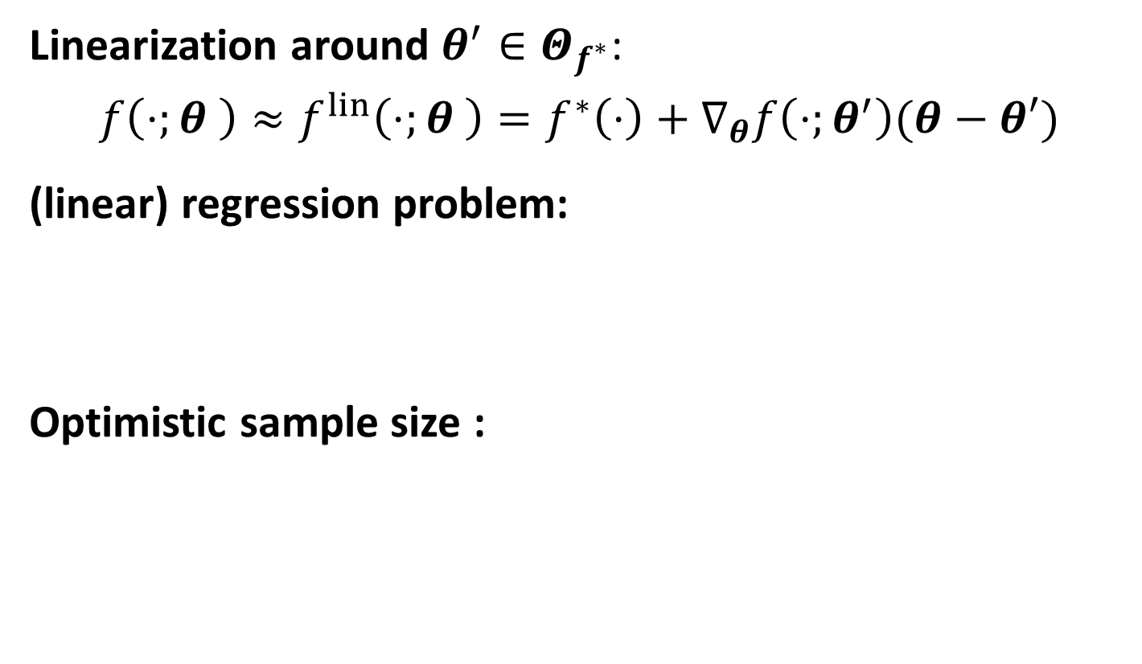

Sample size estimate through linearization
Linearization around $θ^{′}∈Θ_{f^{∗}}$:
$$f\left(⋅;θ \right)≈f^{lin}\left(⋅;θ \right)=f^{∗}\left(⋅\right)+∇_{θ}f\left(⋅;θ^{′}\right)(θ−θ′)$$
(linear) regression problem:
Optimistic sample size :
Model rank at $θ′$：
Yaoyu Zhang*, Zhongwang Zhang, Leyang Zhang, Zhiwei Bai, Tao Luo, Zhi-Qin John Xu*, Optimistic Estimate Uncovers the Potential of Nonlinear Models, arxiv 2307.08921

Slide 23
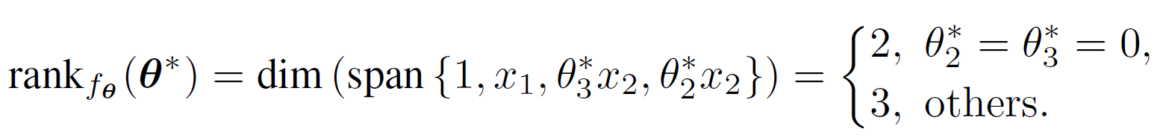
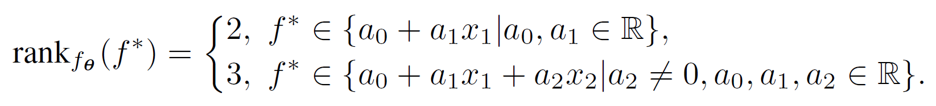
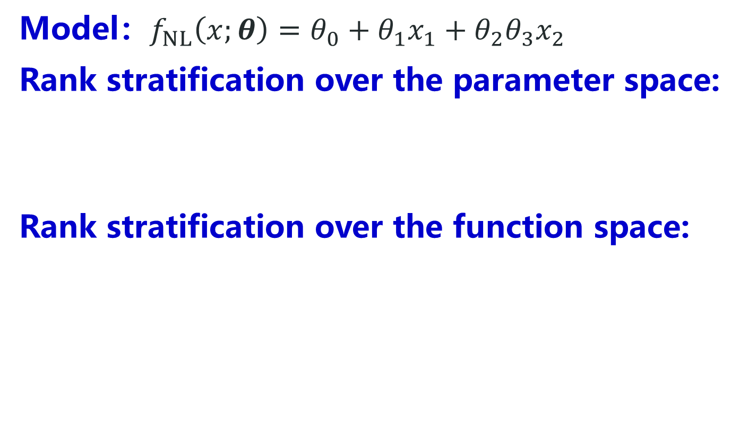
Rank depends on parameter for non-linear model
Model：$f_{NL}\left(x;θ\right)=θ_{0}+θ_{1}x_{1}+θ_{2}θ_{3}x_{2}$
Rank stratification over the parameter space:
Rank stratification over the function space:
VS. $f_{L}\left(x;θ\right)=θ_{0}+θ_{1}x_{1}+θ_{2}x_{2}$ ：constant rank-3
Yaoyu Zhang*, Zhongwang Zhang, Leyang Zhang, Zhiwei Bai, Tao Luo, Zhi-Qin John Xu*, Optimistic Estimate Uncovers the Potential of Nonlinear Models, arxiv 2307.08921

Slide 24
矩阵分解模型的乐观估计
Yaoyu Zhang*, Zhongwang Zhang, Leyang Zhang, Zhiwei Bai, Tao Luo, Zhi-Qin John Xu*, Optimistic Estimate Uncovers the Potential of Nonlinear Models, arxiv 2307.08921

Slide 25
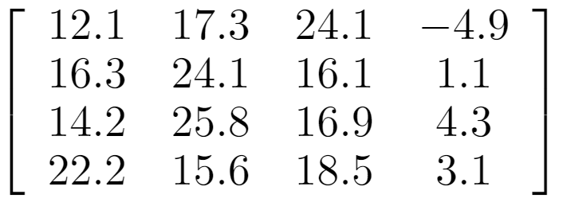
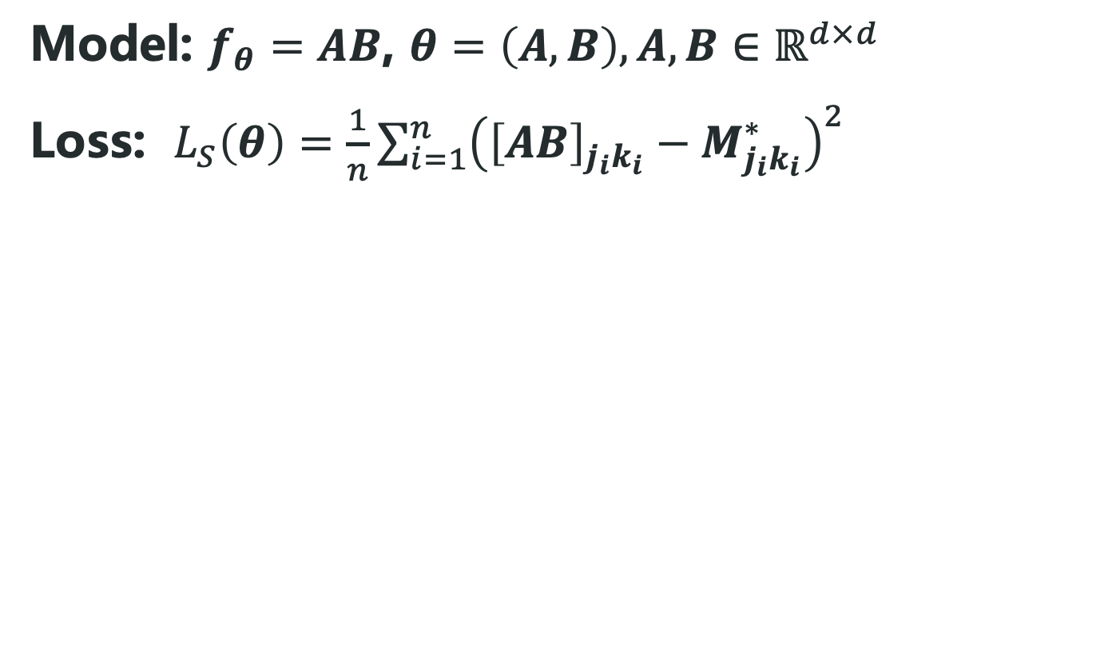

Matrix factorization model
Model: $f_{θ}=AB$, $θ=\left(A,B\right),A,B∈ℝ^{d×d}$
Loss: $L_{S}\left(θ\right)=\frac{1}{n}\sum_{i=1}^{n}{{\left({\left[AB\right]}_{j_{i}k_{i}}−M_{j_{i}k_{i}}^{∗}\right)}^{2}}$
思考：最低秩的填充方案对应秩为多少？

Slide 26
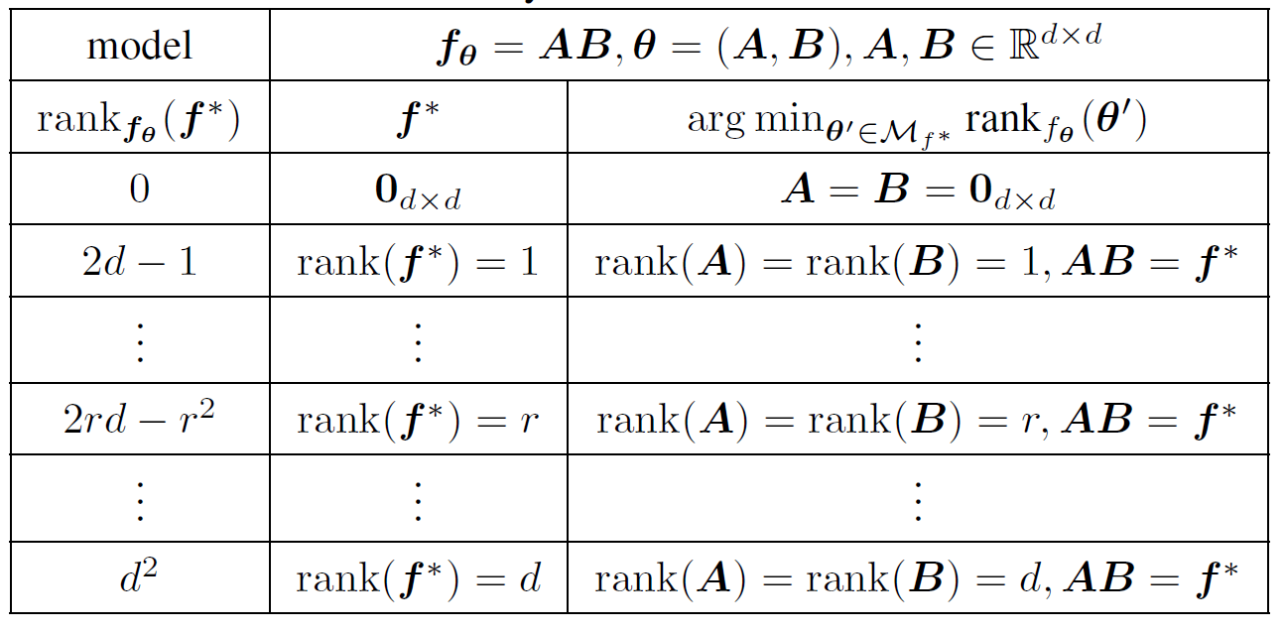
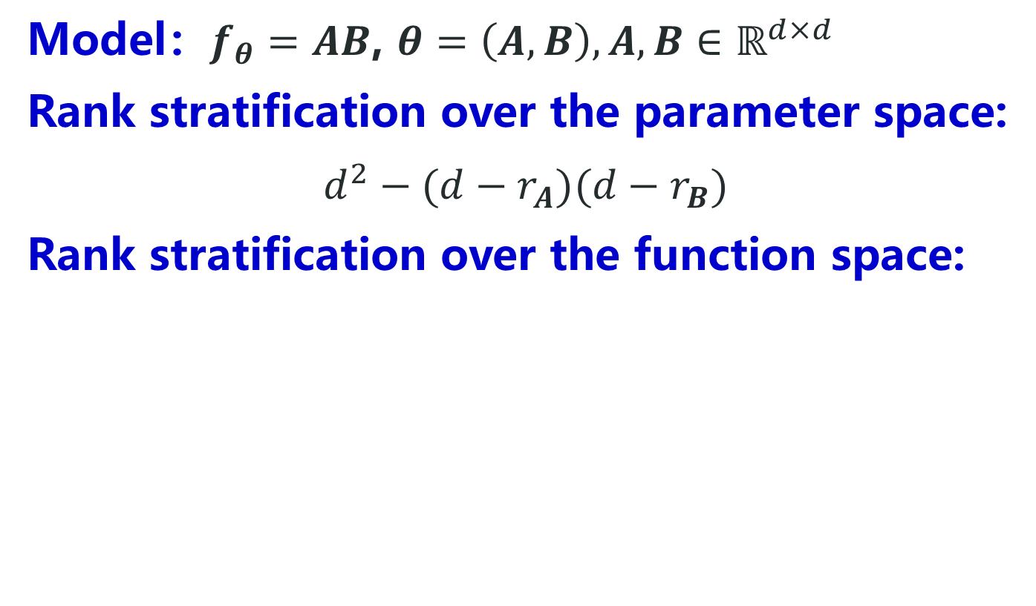
Rank stratification for matrix factorization
Model：$f_{θ}=AB$, $θ=\left(A,B\right),A,B∈ℝ^{d×d}$
Rank stratification over the parameter space:
$$d^{2}−(d−r_{A})(d−r_{B})$$
Rank stratification over the function space:
Yaoyu Zhang*, Zhongwang Zhang, Leyang Zhang, Zhiwei Bai, Tao Luo, Zhi-Qin John Xu*, Optimistic Estimate Uncovers the Potential of Nonlinear Models, arxiv 2307.08921

Slide 27
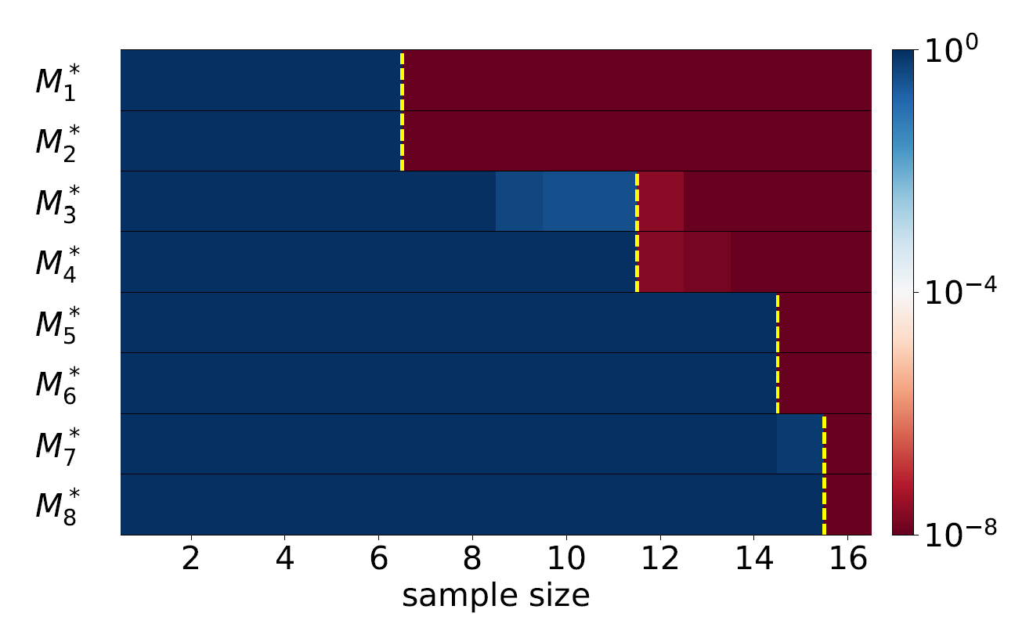
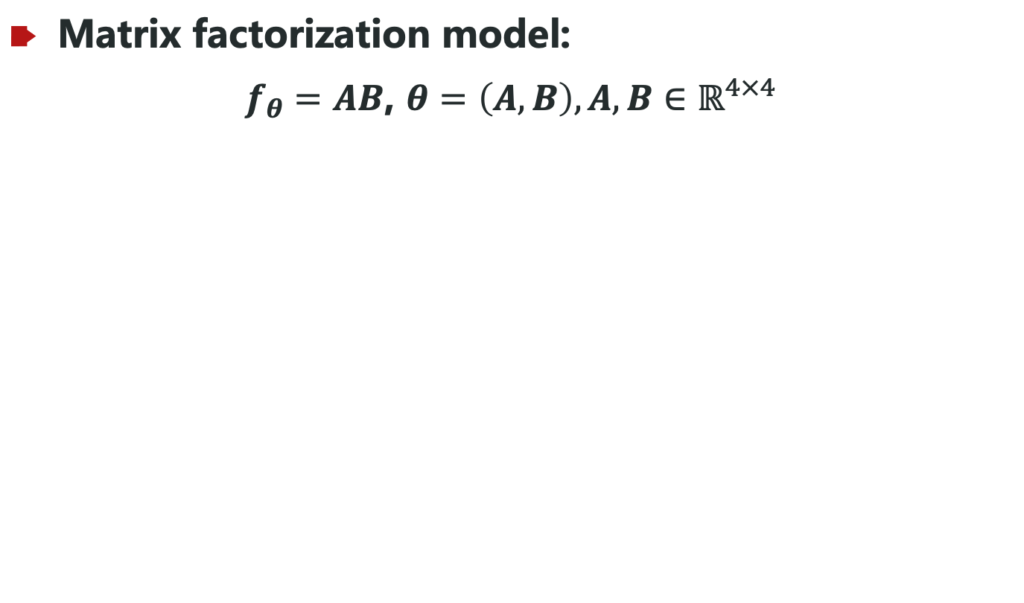
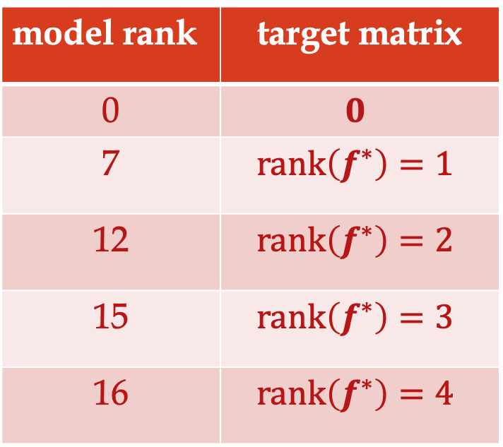
矩阵分解模型
Matrix factorization model:
$f_{θ}=AB$, $θ=\left(A,B\right),A,B∈ℝ^{4×4}$
model rank | target matrix
0 | $$0$$
7 | $$rank\left(f^{∗}\right)=1$$
12 | $$rank\left(f^{∗}\right)=2$$
15 | $$rank\left(f^{∗}\right)=3$$
16 | $$rank\left(f^{∗}\right)=4$$
Yaoyu Zhang*, Zhongwang Zhang, Leyang Zhang, Zhiwei Bai, Tao Luo, Zhi-Qin John Xu*, Optimistic Estimate Uncovers the Potential of Nonlinear Models, arxiv 2307.08921

Slide 28
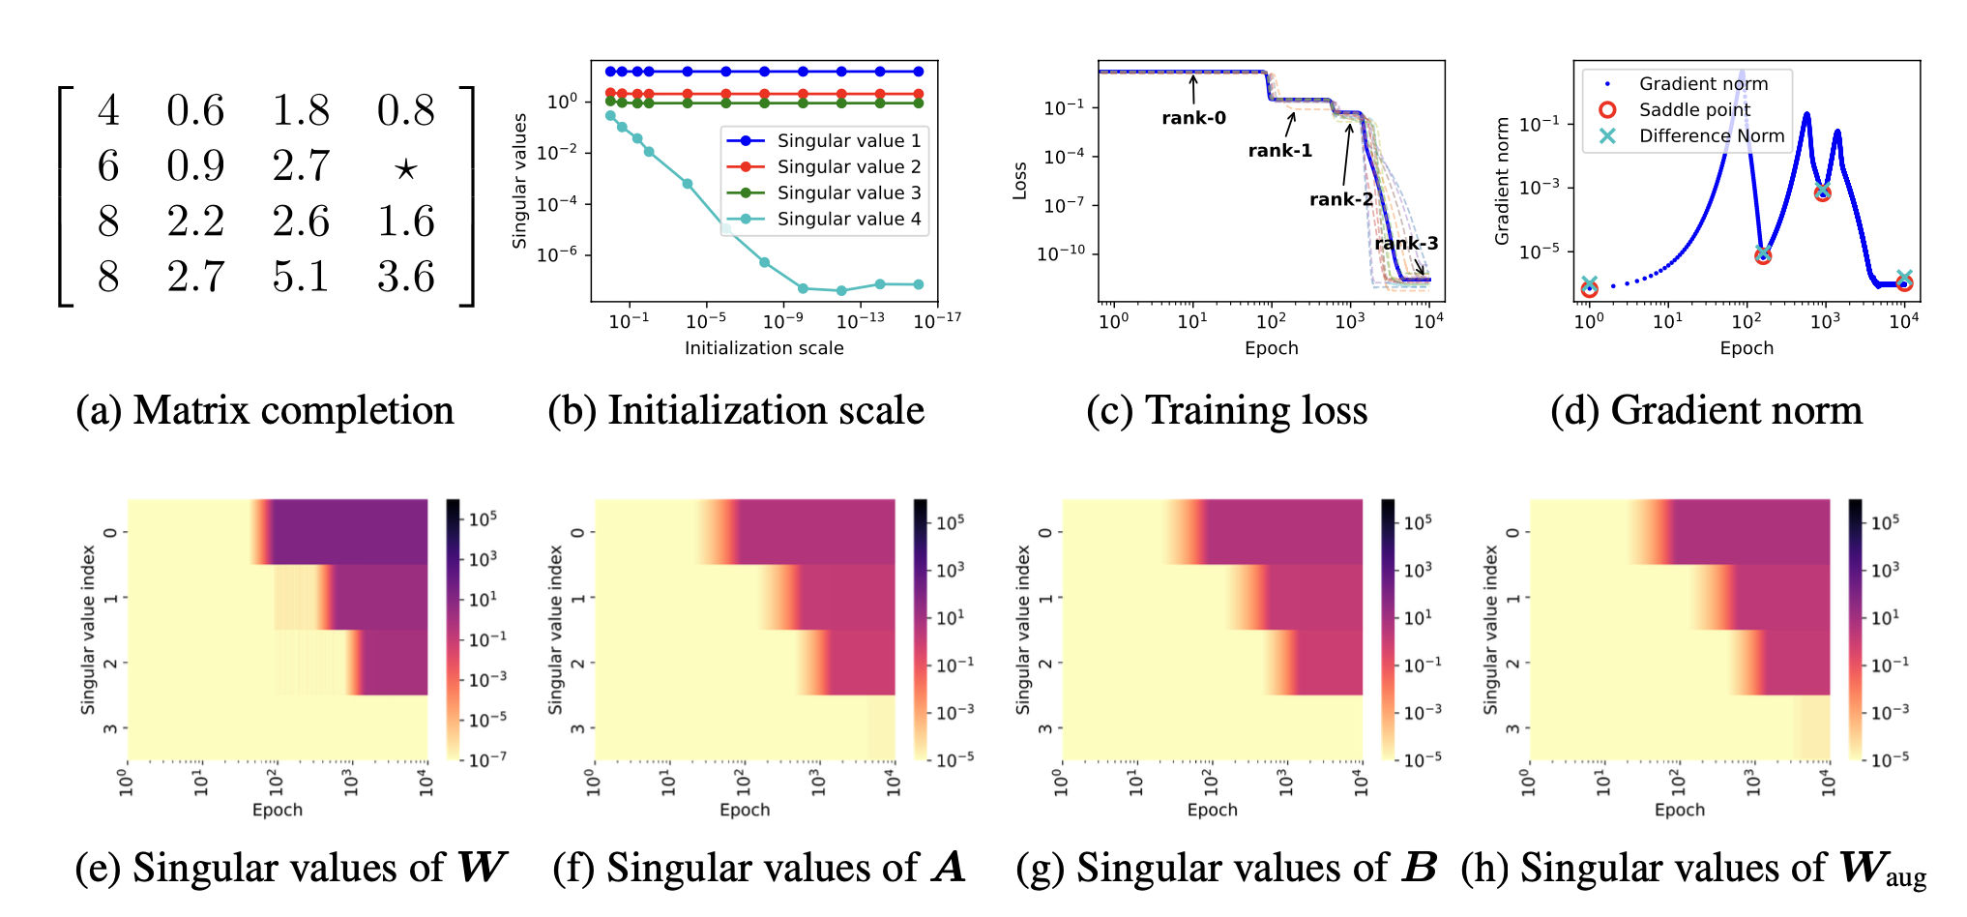
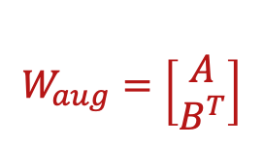
矩阵分解模型的动力学
$$W_{aug}=\begin{matrix} \\ \left[\begin{aligned}A \\ B^{T}\end{aligned}\right]\end{matrix}$$
Hierarchical Invariant Manifold Traversal (HIMT)
Zhiwei Bai, Jiajie Zhao, Yaoyu Zhang Connectivity Shapes Implicit Regularization in Matrix Factorization Models for Matrix Completion https://arxiv.org/abs/2405.13721

Slide 29
神经网络的乐观估计
Yaoyu Zhang*, Zhongwang Zhang, Leyang Zhang, Zhiwei Bai, Tao Luo, Zhi-Qin John Xu*, Optimistic Estimate Uncovers the Potential of Nonlinear Models, arxiv 2307.08921

Slide 30
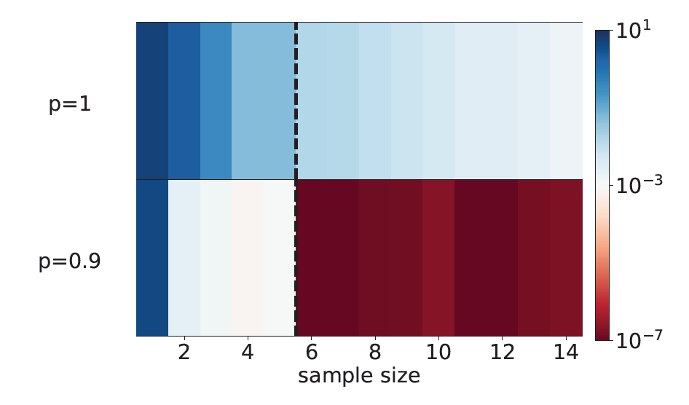
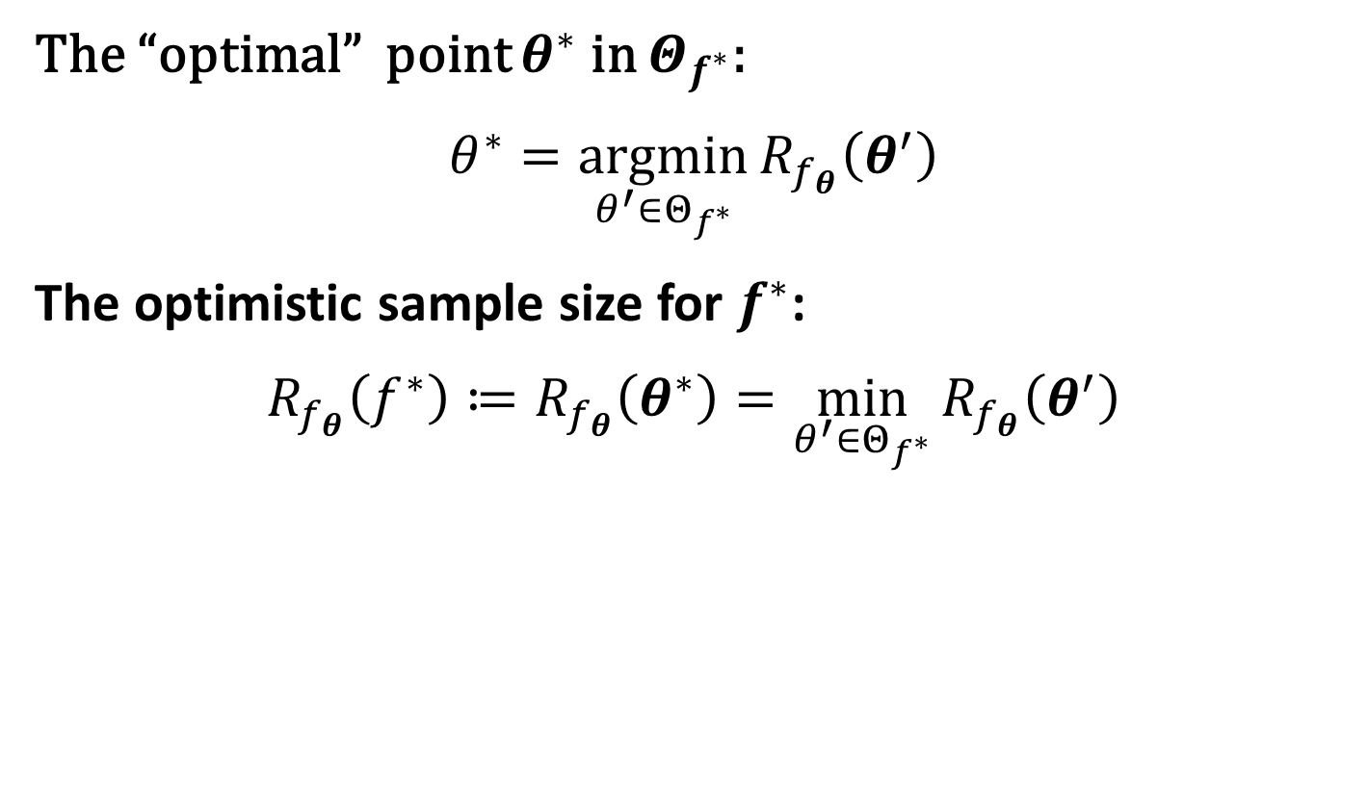
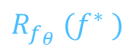
Optimistic sample size for $f^{∗}$
The “optimal” point $θ^{∗}$ in $Θ_{f^{∗}}$:
$$θ^{∗}=\underset{θ^{′}∈Θ_{f^{∗}}}{argmin}{R_{f_{θ}}\left(θ^{′}\right)}$$
The optimistic sample size for $f^{∗}$:
$$R_{f_{θ}}\left(f^{∗}\right)≔R_{f_{θ}}\left(θ^{∗}\right)=\min_{θ^{′}∈Θ_{f^{∗}}}{R_{f_{θ}}\left(θ^{′}\right)}$$
……
Model
Target
Optimistic CASE: 6 samples
0
$R_{f_{θ}} (f^{∗} )$
M
Yaoyu Zhang*, Zhongwang Zhang, Leyang Zhang, Zhiwei Bai, Tao Luo, Zhi-Qin John Xu*, Optimistic Estimate Uncovers the Potential of Nonlinear Models, arxiv 2307.08921

Slide 31
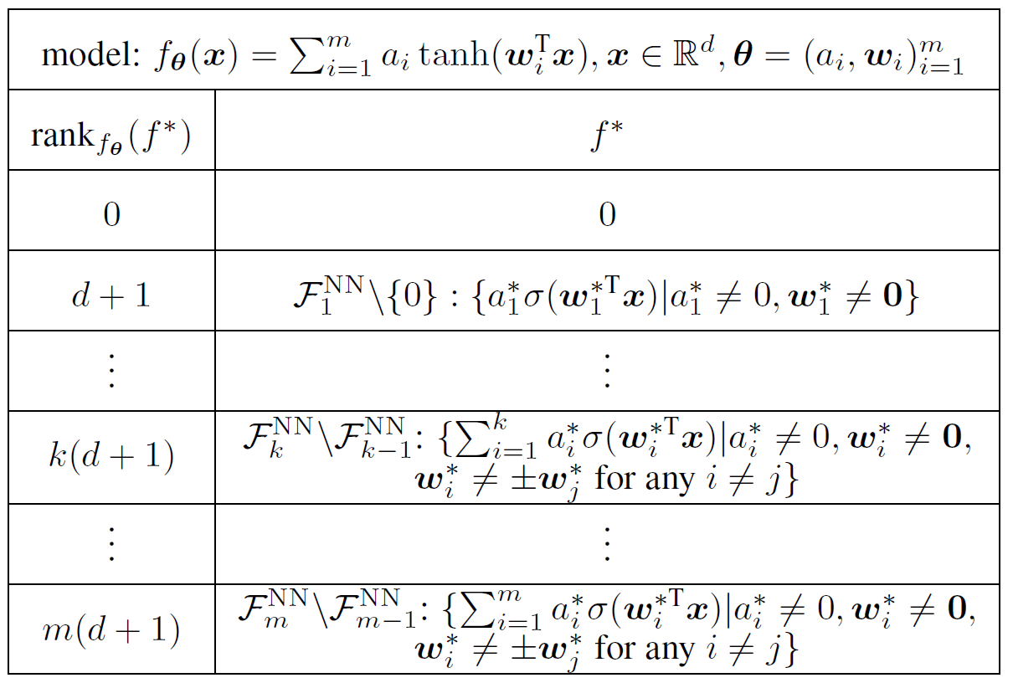
Rank stratification for fully-connected NNs
Free expressiveness in width: expanding the width of NN does not increase the optimistic sample sizes.
Yaoyu Zhang*, Zhongwang Zhang, Leyang Zhang, Zhiwei Bai, Tao Luo, Zhi-Qin John Xu*, Optimistic Estimate Uncovers the Potential of Nonlinear Models, arxiv 2307.08921

Slide 32
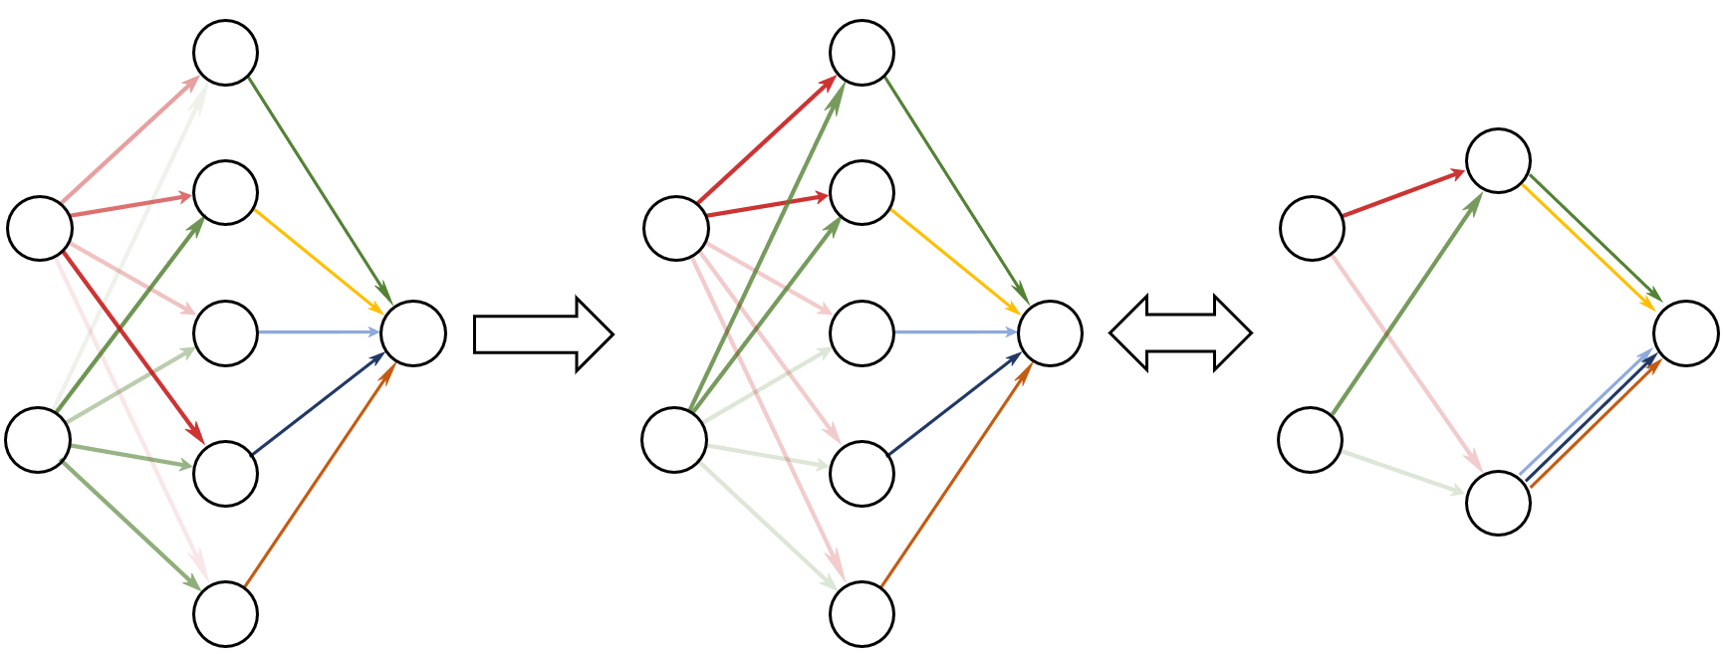
Condensed neurons has same tangent space
Initial: Neurons different
After training: Clustered
Effective small net
Condense
Embedding
Luo#, Xu#, Ma, Zhang*, JMLR, 2021

Slide 33
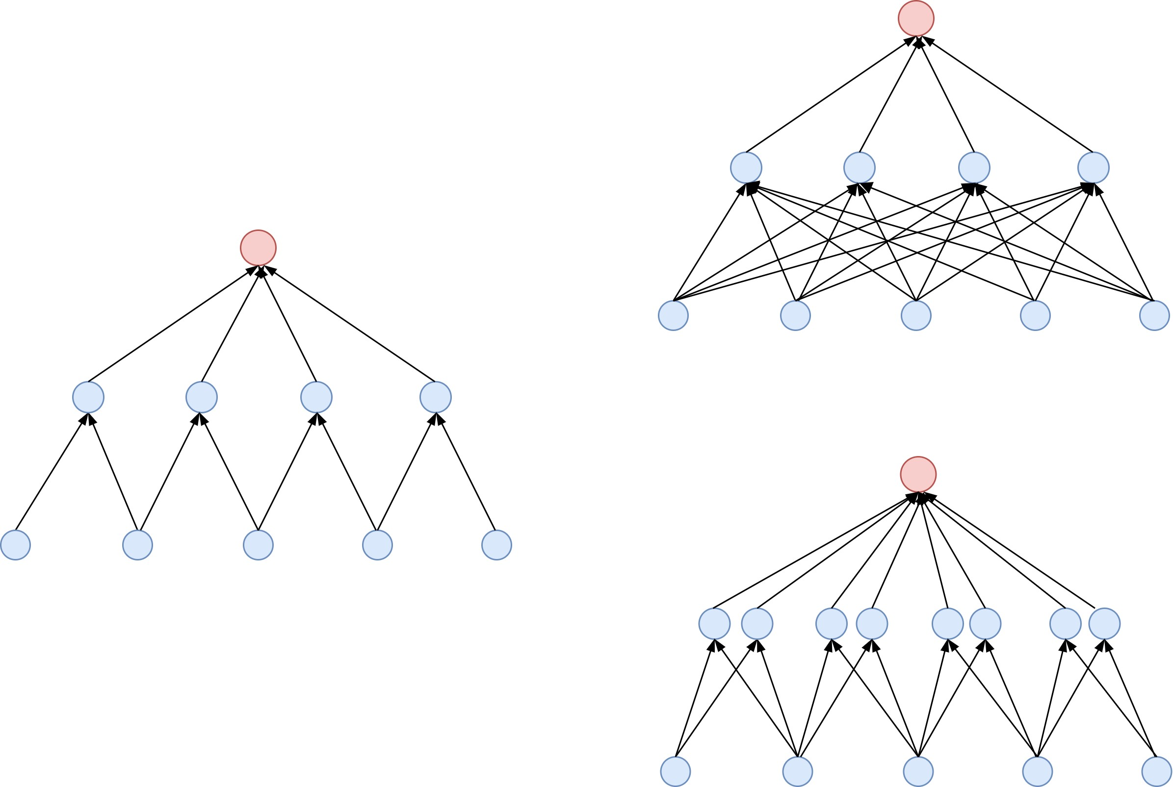
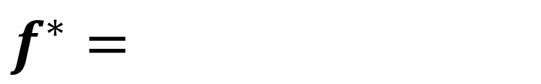
Which is the better way to increase complexity?
$f^{∗}=$
vs.
vs.
12
24
24
Yaoyu Zhang*, Zhongwang Zhang, Leyang Zhang, Zhiwei Bai, Tao Luo, Zhi-Qin John Xu*, Optimistic Estimate Uncovers the Potential of Nonlinear Models, arxiv 2307.08921

Slide 34
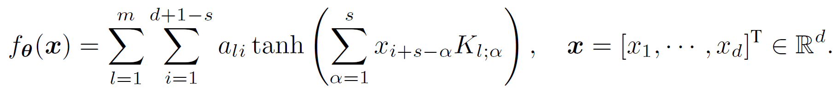
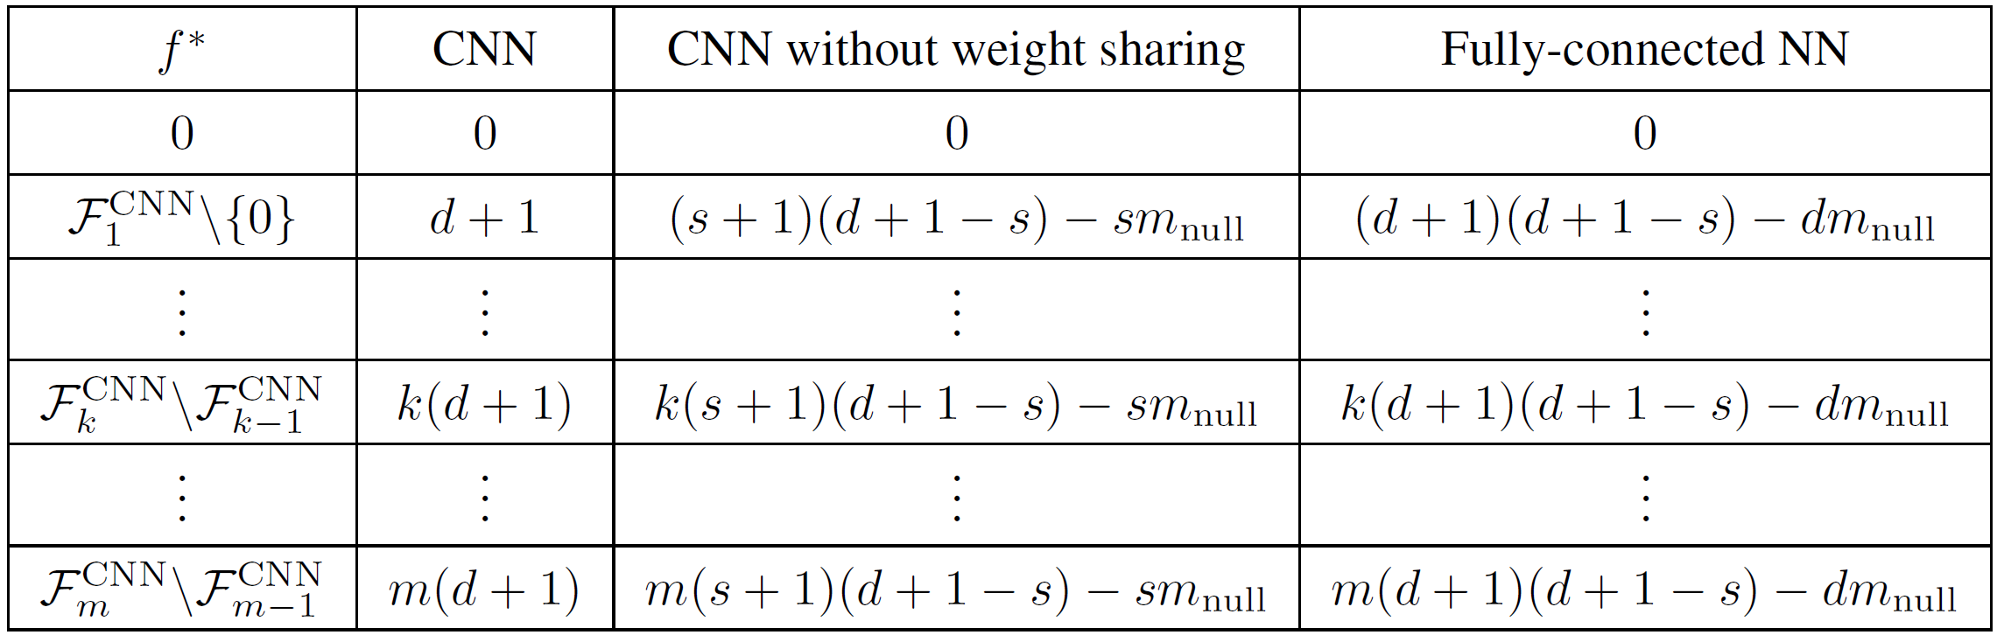
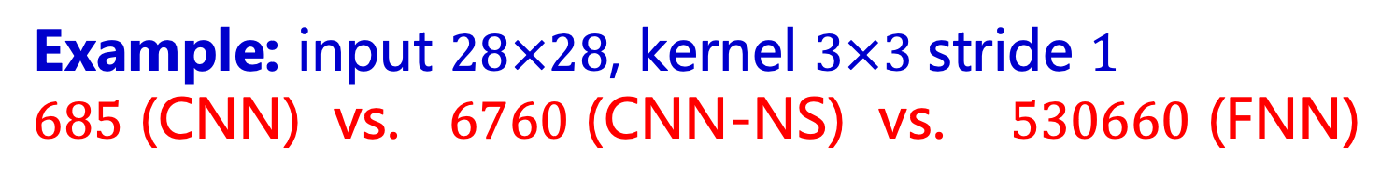
CNN vs. CNN (no-sharing) vs. fully-connected NN
Example: input $28×28$, kernel $3×3$ stride $1$
$685$ (CNN) vs. $6760$ (CNN-NS) vs. $530660$ (FNN)
Yaoyu Zhang*, Zhongwang Zhang, Leyang Zhang, Zhiwei Bai, Tao Luo, Zhi-Qin John Xu*, Optimistic Estimate Uncovers the Potential of Nonlinear Models, arxiv 2307.08921

Slide 35
Which is the better way to increase complexity?
costly expressiveness
costly expressiveness
Each connection increases local dim
24
vs.
24
vs.
12
Condensation
Neuron does not
increases local dim
12
free expressiveness
free expressiveness
24
24
Yaoyu Zhang*, Zhongwang Zhang, Leyang Zhang, Zhiwei Bai, Tao Luo, Zhi-Qin John Xu*, Optimistic Estimate Uncovers the Potential of Nonlinear Models, arxiv 2307.08921

Slide 36
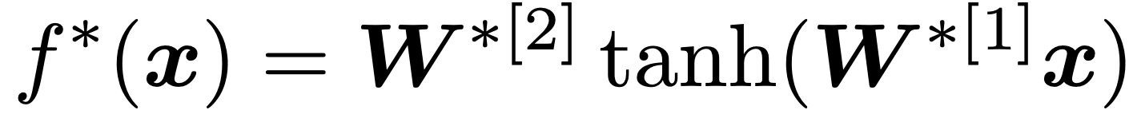
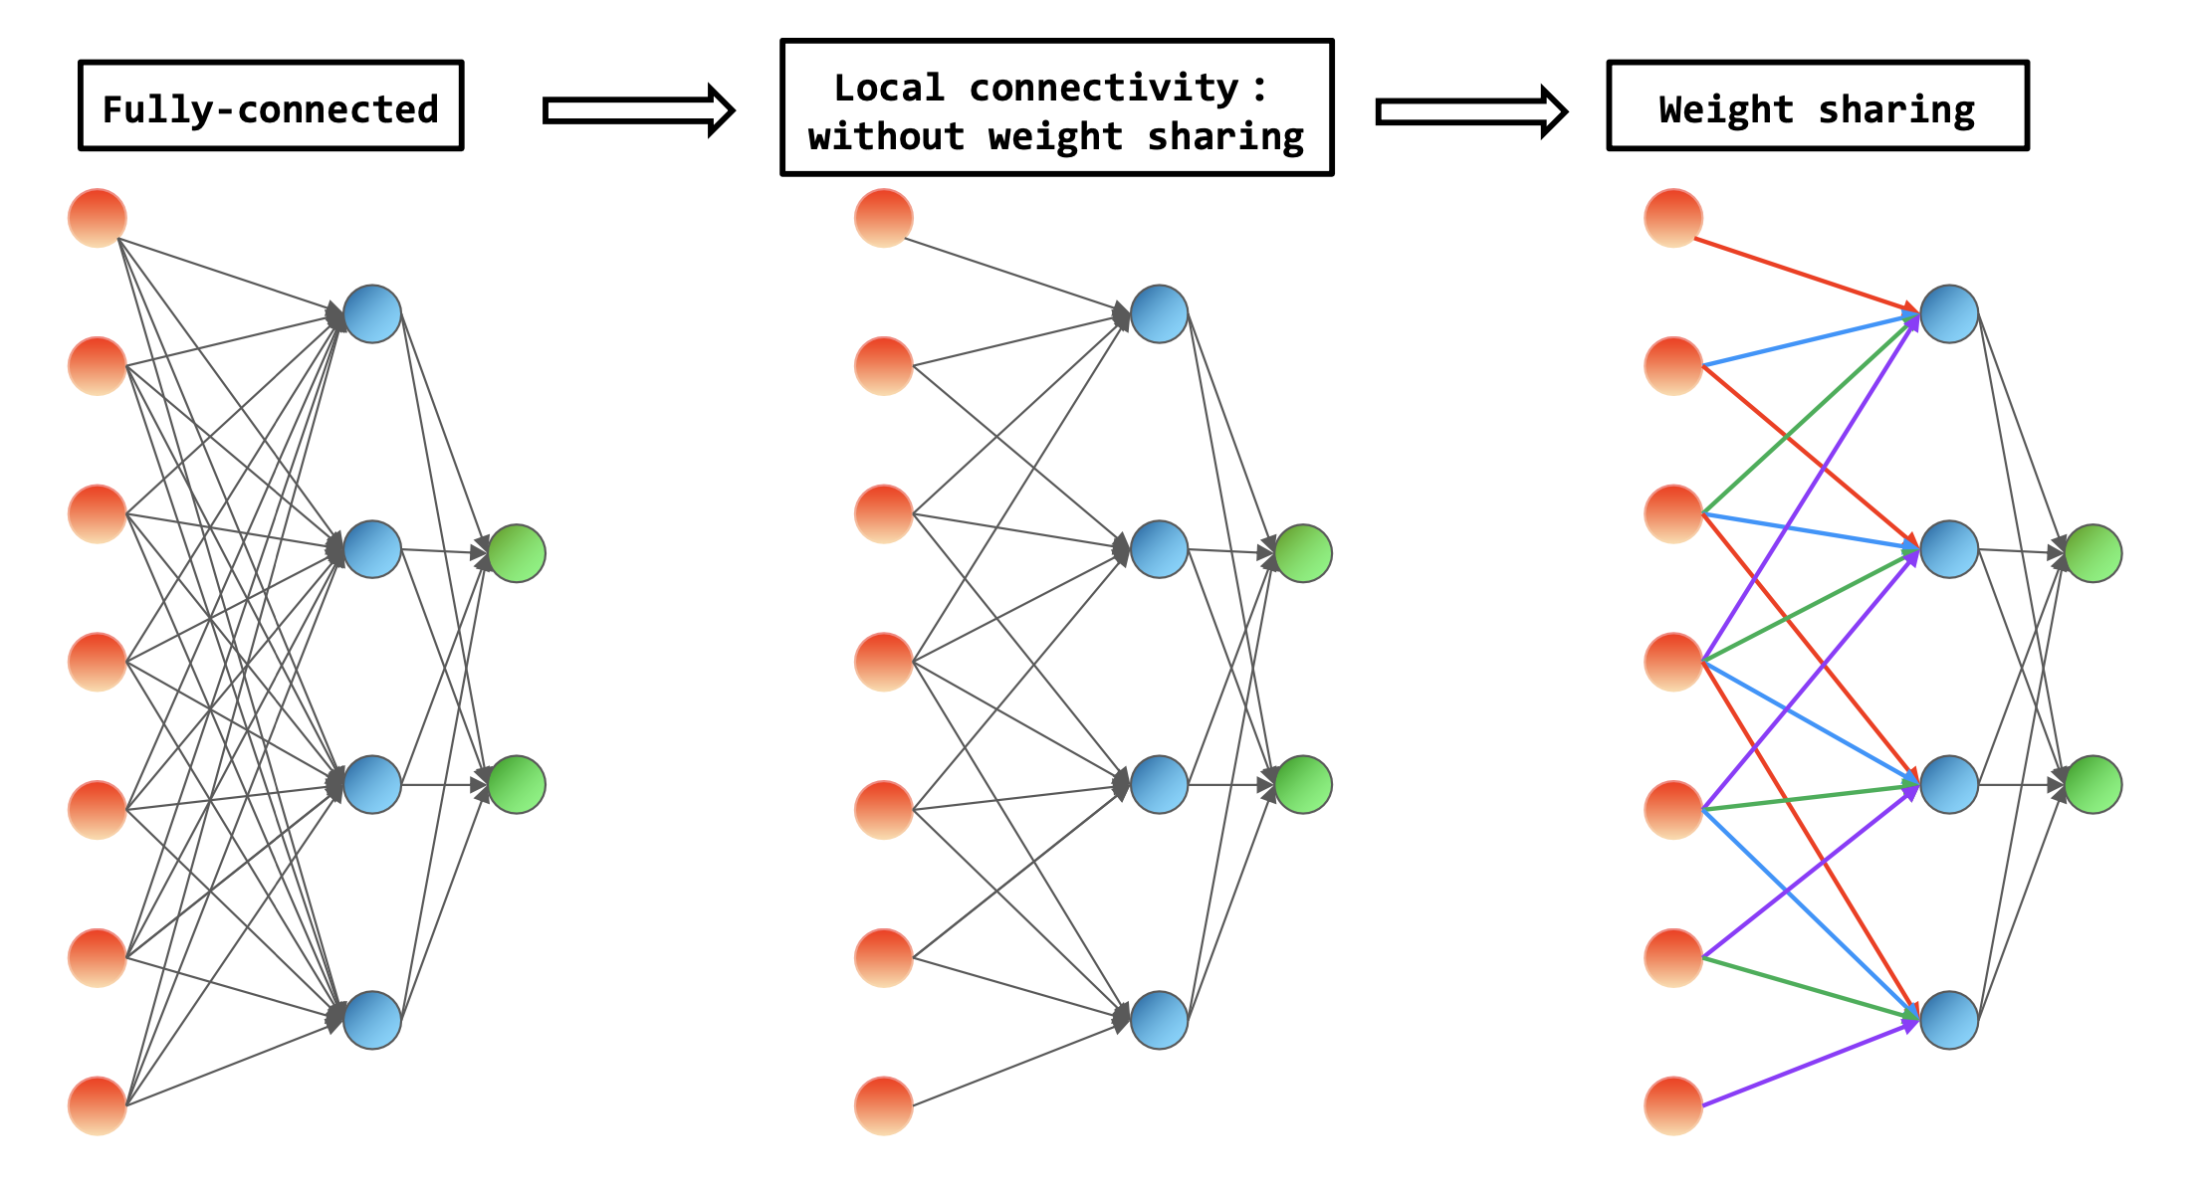
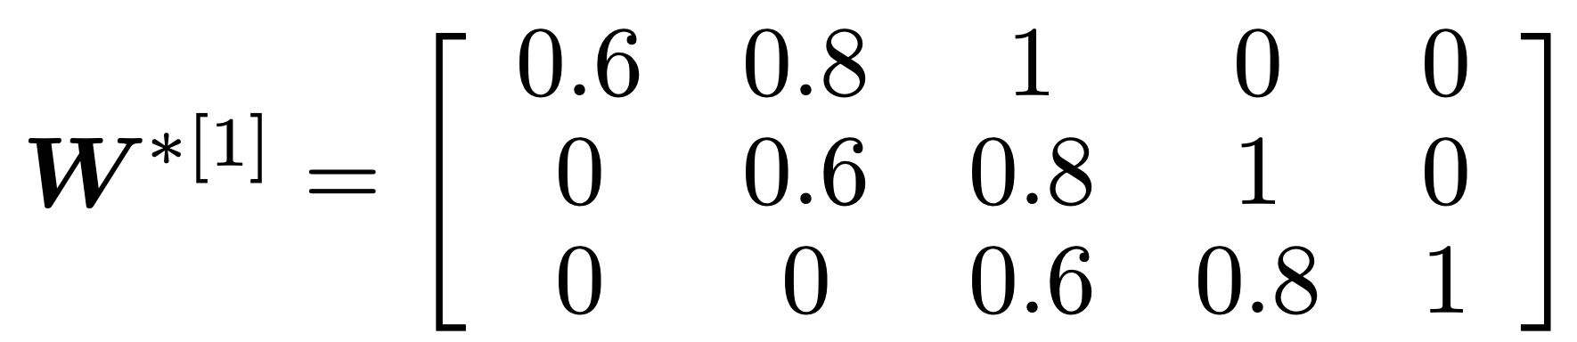

Target function
Model：
DNN
CNN without weight sharing
CNN with weight sharing
Yaoyu Zhang*, Zhongwang Zhang, Leyang Zhang, Zhiwei Bai, Tao Luo, Zhi-Qin John Xu*, Optimistic Estimate Uncovers the Potential of Nonlinear Models, arxiv 2307.08921

Slide 37




CNN needs more data than FNN
$$M=2100$$
$$M=1500$$
$$M=700$$
Yaoyu Zhang*, Zhongwang Zhang, Leyang Zhang, Zhiwei Bai, Tao Luo, Zhi-Qin John Xu*, Optimistic Estimate Uncovers the Potential of Nonlinear Models, arxiv 2307.08921

Slide 38
How to achieve optimistic estimation? One example: why condensation happens?

Slide 39
全局极小值附近的结构(高阶）

Slide 40



全局极小点附近的结构
$$f\left(⋅;θ \right)≈f^{lin}\left(⋅;θ \right)=f^{∗}\left(⋅\right)+∇_{θ}f\left(⋅;θ^{′}\right)(θ−θ′)$$
当样本量达到乐观样本量时，我们把这种恢复叫做“局部线性恢复”，即模型能够恢复目标函数的线性近似。
有时候我们还期待完全恢复目标函数，这就是所谓的“局部恢复”。
一个合理的推测是，局部恢复需要的样本量大于乐观样本量？
局部恢复的样本量比乐观样本量多多少呢?
在过参数化下，有没有可能实现局部恢复?
Zhang, L., Zhang, Y. & Luo, T. (2023), ‘Structure and gradient dynamics near global minima of two-layer neural networks’, arXiv preprint arXiv:2309.00508

Slide 41

全局极小点附近的结构

Slide 42



全局极小点附近的结构
Jiajie Zhao, Zhiwei Bai, Yaoyu Zhang
Disentangle Sample Size and Initialization Effect on Perfect Generalization for Single-Neuron Target. arXiv:2405.13787

Slide 43

习题

Slide 44

习题

